Slide 1
Bluetooth Wall Outlet
Josh Howard 4/16/2020

Slide 2
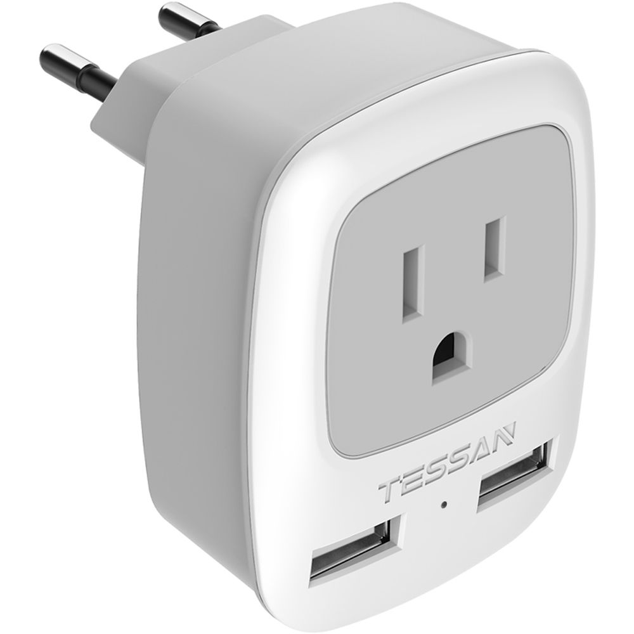
What the outlet does
Plug into the wall and pass power through to a small appliance.
Be able to control the appliance by turning it off and on remotely.
Uses Bluetooth capability to be able to do this with a phone.

Slide 3

Research done to implement this.
How does Bluetooth work with an Arduino
How is data transferred over Bluetooth and how does the Arduino read this.
Working with high/low voltage from a wall outlet.

Slide 4
What can it do?
Capabilites
Limitations
Can take any appliance that uses a two prong plug.
15-20 Meter range
The capabilities are also the limitations
It can not take the more common 3 prong plug
Since it is BLE and the range only being 20~ meters, you cannot control it outside of your home.

Slide 5
Improvements
Change the 9v battery to internal power.
Add a ground pin to make it 3 prong compatible.
Add in Wifi capability to add long distance control

Slide 6
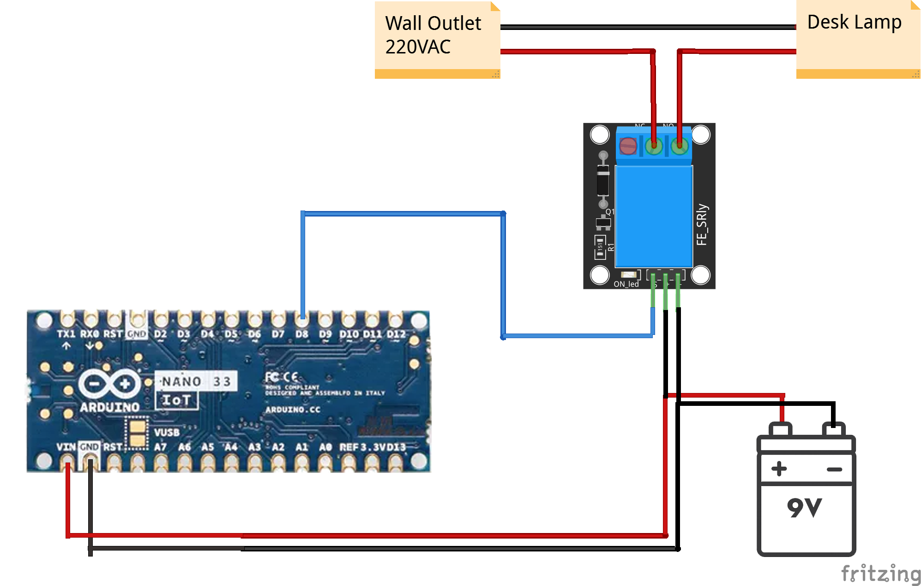
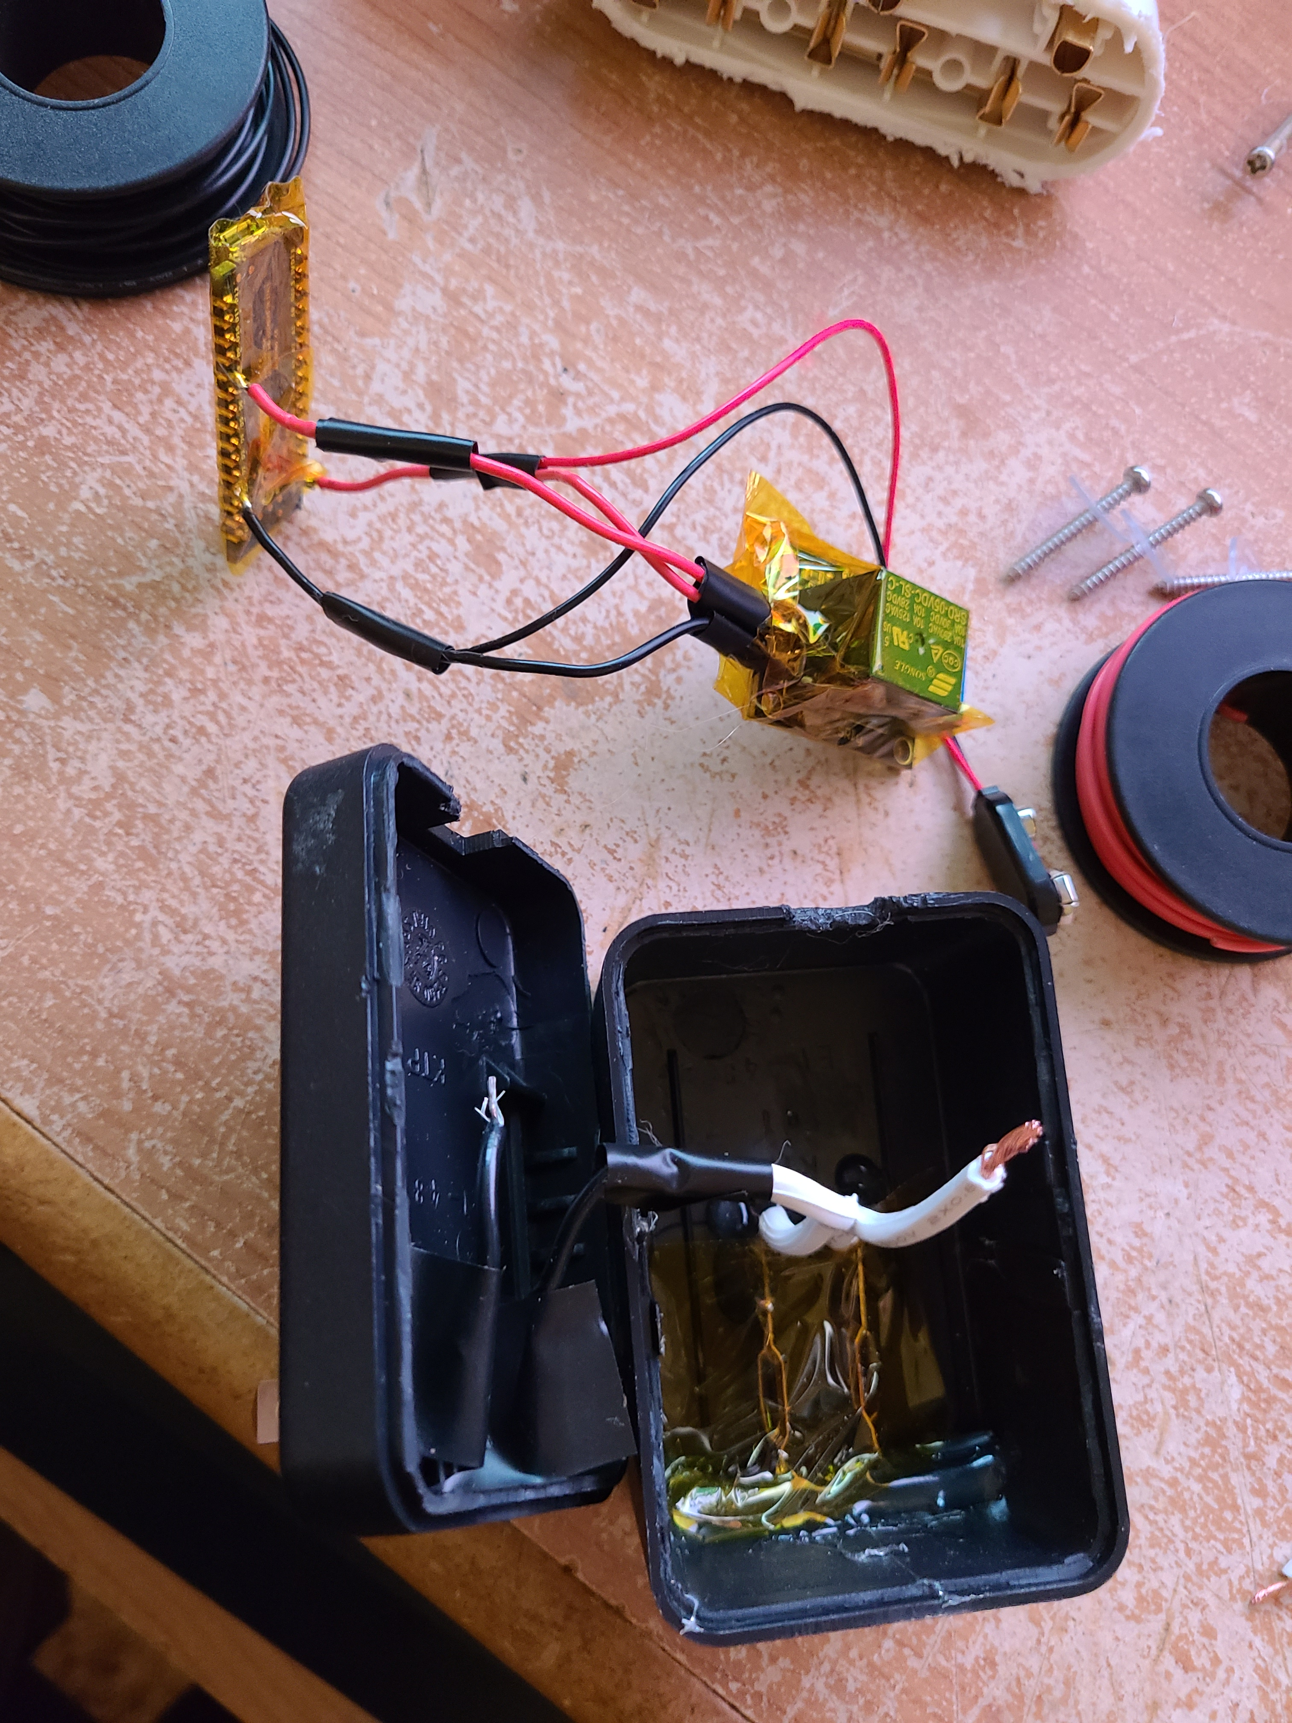
Details

